Slide 1
CHAPTER ONE
UNDERSTANDING INTERNATIONAL RELATIONS(IR)

Slide 2
1.1. Conceptualizing Nationalism, Nations and States
Disparate events of IR include;
  leaders are meeting,
  negotiations are concluded,
  wars are started,
  acts of terror committed, and so on.
Nationalism-is the most influential force in international affairs.
  used to reshape and reinforce regimes in history.
nationalism is the doctrine that asserts the nation as the basic political unit in organizing society (Heywood, 2014).
Nations are historical entities that evolve organically out of more similar ethnic communities and they reveal themselves in myths, legends, and songs.

Slide 3
Cont’d
A nation, in contrast to a state, constitutes a community of people joined by a shared identity and by common social practices.
Communities of various kinds with a political concern is known as ‘nation-state’.
nationalist leaders argue that the nation should take over the state and make use of its institutional structures to further the nation‘s ends.
The nation added an interior life to the state.
The revolutions in Britain‘s North American colonies in 1776, and in France in 1789, provided models for other nationalists to follow.
Nationalism in the first part of the 19th c. was a liberal sentiment concerning self-determination: the right of a people to determine its own fate.

Slide 4
Cont’d
The idea of self-determination undermined the political legitimacy of Europe‘s empires.
In 1848, the prospect of self-determination seemed to become a reality as nationalist uprisings quickly spread across the continent.
With the end of the WW I in 1918, the right to self-determination was acknowledged as a right.
After the WW I, most people in Europe formed their own nation-states.
The European international system (IS) became for the first time truly ‘inter-national’ due to the nationalist revolutions.
Unlike the Westphalian system, world affairs in the 19th c. increasingly came to concern relations between nation-states.

Slide 5
Cont’d
In most respects, however, the inter-national system continued to operate in much the same fashion as the Westphalian inter-state system.
Nation-states claimed the same right to sovereignty.
In international politics, nevertheless, the implication of nationalism and its essence is highly questioned.
However, with the post-cold war, a revival of nationalism is happening across the world with the post-cold war assertions of religion, culture and ethnicity as potent forces in world politics.

Slide 6
1.2. Understanding IR
The world is in the feature of interconnectedness- geographically, intellectually and socially
Originally, IR is a branch of the study of law, philosophy or history. However, given the diverse origins of IR.
So, there is no one accepted way of defining or understanding international relations.
Today, IR describes a range of interactions between people, groups, firms, associations, parties, nations or states.
Fundamental events in the study of IR such as:
  international conflict
  international conferences on global warming and
  international crime

Slide 7
Cont’d
No individual, people, nation or state can exist in splendid isolation or be master of its own fate.
Every people, nation or state is a minority in a world that is anarchic- there is an absence of a common sovereign power over them.
In the absence of any ruler, world politics is pluralistic and diverse.
Differences between domestic and international politics:
  Domestic law is-
    generally obeyed,
    the police and courts enforce sanctions.
    a government has a monopoly on the legitimate use of force
  International law-
    rests on competing legal systems,
    there is no common enforcement.
In international politics, no one has a monopoly of force.
International politics has often been interpreted as the realm of self-help.

Slide 8
Cont’d
Studying IR provides the necessary tools to analyze events, and to gain a deeper comprehension of some of the problems that policy-makers confront and to understand the reasoning behind their actions.
Some of the scholars and practitioners include:
T. Hobbes (1651) interpreted the state of society to be: ‘continual fear, and danger of violent death; and the life of man, solitary, poor, nasty, brutish, and short‘ –Pessimistic view.
J. Locke suggested that sociability was the strongest bond between men –men were equal, sociable and free; but they were not licentious because they were governed by the laws of nature.
Took a more optimistic view and believe that nature did not arm man against man.

Slide 9
Cont’d
International politics involves the delicate adjustment of power to power.
In order to resolve disagreements states and IO can come up with a way of resolving differences.
International politics is also about maintaining international order, maintained in an anarchical world.
The arena of IR and politics seems to be continually expanding with:
  the multiplication of independent states.
  the continuing growth of governmental and international services.
IR and politics are necessary for all states, but political power is not centralized and unequal.

Slide 10
1.3. The Nature and Evolution of IR
In the medieval Europe the two institutions with pretensions to power over the continent
  The (Catholic) Church
  the Empire.
The Church:
  The spiritual authority, centered in Rome
  occupied a crucial role in the cultural and intellectual life of the middle Ages.
The Empire:
  known as the Holy Roman Empire
  established in the 10th C. in central Europe.
  derived legitimacy from the Roman Empire.
  but had none of its political power.

Slide 11
Cont’d
The political system of medieval Europe was a curious combination of the local and the universal.
Since the 14th C. onward European political system was located at an intermediate level between the local and the universal.
On the universal level: the new states simultaneously set themselves in opposition to popes and emperors.
On the local level: in opposition to feudal lords, peasants and assorted other rulers .
With the Reformation in the 16th C. the notion of a unified Europe broke down completely as the Church began to split apart.
The new ‘Protestant’ churches became state-run and church lands became property of the state.
The increasingly self-assertive states were picking fights with universal institutions and with local ones.
Rejected the traditional claims of all local authorities

Slide 12
Cont’d
The European states emerged in the midst of struggle and strife, and have continued to characterize their existence.
The Thirty Years’ War, 1618–1648(a religious conflict)-the bloodiest and most protracted military confrontation of the era.
Then, the Treaty of Westphalia (1648) has come to symbolize the new way of organizing international politics.
  international politics become a matter of state to state relations.
  All states become sovereign.
  All states were formally equal
  They had the same rights and obligations.
  The practices of diplomacy expanded to include many provisions
But, Sovereignty and formal equality led to the problem of anarchy.
Diplomatic practices were never powerful enough to prevent war, but they did provide Europeans with a sense of a common identity.

Slide 13
Cont’d
The European model of statehood and the European way of organizing IR eventually came to organize all of world politics.
In the 19th c., relations between Europe and the rest of the world were irrevocably transformed due to economic changes taking place in Europe itself.
In the end of the 19th c., colonial possessions became a symbol of “great power‘ status.
So, the colonized peoples had no nation-states and enjoyed no self-determination.
In the process of liberating themselves from the colonizers, they copied European models.
So, to become independent was based on European terms of independent.
The Europe-like states was thus the project of all non-European political leaders engaged.

Slide 14
1.4. Actors in International Relations
1.4.1. State Actors
A state is composed of:
  territorial unit
  control over military for defense
  Economic control and governmental bureaucracy
States are similar to each other in respects to:
  all states have their own capitals, armies, foreign ministries, flags and national anthems.
  All states call themselves ‘sovereign’
IR traditionally focused on interactions between states.
States or nation-states have the primacy in the global interactions

Slide 15
Cont’d
The ‘international’ is hence structurally differentiated from the ‘domestic’
  The ‘international-‘anarchical’,
  The ‘domestic’ is hierarchical.

Slide 16
1.4.2. Non-State Actors
NSAs do not represent states, but have great influent in the IS.
share some of the characteristics of states.
NSAs in the IR include:
  TNC, MNCs, IGOs and NGOs, INGOs
  Epistemic community (Network of professionals and experts)
  Sub-state Actors
The increased focus on non-state actors and cross-border issues has marked a close-to-revolutionary turn in IR.
This is a shift away from the inter-national (‘between-states’) to the ‘trans-national’ (‘across/beyond-states’ and their borders).
world affairs in ‘trans-national’ terms seems more of an analytical necessity than just a choice.
The increasing ability for common people has changed lives at personal and community levels also dramatically altered the general dynamics in politics and global affairs.

Slide 17
1.5. Levels of Analysis in International Relations
Levels of analysis-ways of analyzing how foreign policy decisions are made at various levels of the state.
The international system is complex.
1.5.1. The individual level
holds moral principles of individuals may translate into that of nations and form of government.
IR is influenced by nature of “Man” (“Man seeks Power)
refer to the behaviour and events surrounding leaders as transferrable outside national boundaries to create a chain reaction and global phenomenon.
key decision makers such as presidents and foreign minister affect international relations.

Slide 18
Cont’d
Their thoughts, perceptions, and attitudes can determine whether a nation goes to war or stays at peace.
Generally, the psychological factor of leaders affect their actions and decisions in the international affairs.

Slide 19
Cont’d
1.5.2. The group level:
break the analysis down into certain kinds of groups.
It is when the group behavior influences the IS.
relate to the state level and where they position themselves with respect to the global dimension of the issues they are dealing with
  Example; lobbying groups influence national decision making on an issue.
In this sense, it would be more interested in the actions of groups of individuals
could be interested in activist/pressure groups
These influence the global debate about the winners and losers of globalization and capitalism

Slide 20
Cont’d
1.5.3. The state level:
The IS depends on nature of States.
The state is the dominant unit of analysis
Focus on the state to as the relative ‘state-centrism’ of the discipline.
State is both the central unit of analysis and a point of reference for other types of actors.
The assumption is that the state being the main location of power within the international sphere.
World politics is characterized by the behaviour of state, whose actions determine the global system.
The inactions of states could also shape international and the domestic politics of states.

Slide 21
Cont’d
This level is strengthened by the fact that all non-state actors do not exist outside state boundaries.
The state gives political and legal expression to the non-state actors.
E.g. During the Cold War, much of international affairs appeared to be run via state channels in line with particular state interests.
States still hold the exclusive right to the legitimate use of physical force.

Slide 22
Cont’d
1.5.4. The system level:
The international system is an Interaction among Units
The structure of global system is a context within which states cooperate, compete and confront each other over issues of national interest.
The global context determines the distribution of power amongst states.
Determine the ability and opportunity of a state and groups of states to pursue their interests.
Consider global linkages that go beyond single interactions between states, such as the global economy, transnational terrorism or the internet.
Nature of the IS determines the behaviour of states and the attitudes of leaders or governments.
This comes with the assumption that our international system is ‘anarchic’
The structure of IP compels states to act in the international system.

Slide 23
1.6. The Structure of International System
Based on the scholars in IR, political power is usually distributed into three main types of systems:
Unipolar system: there is one state with the greatest political, economic, cultural and military power .
  Only one state has the ability to totally control other states.
Bipolar system :there are two dominant states (super powers)
  The less powerful states join either sides through alliance and counter alliance formations.
  vulnerable for zero-sum game politics
  E.g. During the cold war period
Multipolar system: the most common throughout history.
  various equally powerful states competing for power.
  Zero-sum game is not necessary for states to change their relationship.
  it was a typical world system during the World War I.

Slide 24
Key Concepts in IRs
Power: Power is the currency of international politics.
  It is the ability to get something or to do something.
  It determines the relative influence of actors.
  it shapes the structure of the Is.
  Power is the blood line of international relations.
Anarchy: Refers to lack of a central government (or international sovereign) that regulates states interaction in global politics.
  Within a country ‘anarchy’ refers to a breakdown of law and order.
  In State relations, it refers to a system where power is decentralized without shared institutions with the right to enforce common rules.
  Thus, states had to rely on their own resources or to form alliances.

Slide 25
Cont’d
Sovereignty :State sovereignty comes to be the defining element in the study of IR.
  can be defined as an expression of:
    Internal sovereignty-a state‘s ultimate authority within its territorial entity i.e. Freedom in its domestic affairs .
    External sovereignty-the state‘s involvement in the international community i.e. autonomy in foreign policy.

Slide 26
1.7. Theories of International Relations
1.7.1. Idealism/Liberalism: The assumptions are:
View human beings as innately good.
Believe peace and harmony between nations is achievable and desirable.
States are not the only important actors in world politics.
Permanent cessation of war is an attainable goal.
Cooperation among states is made possible
Power is not the only thing that matters
States have common interests and common values
Trade is the key common interest
International system is based on laws (Treaties) and institutions
focus on the creation of a peaceful world by integration
The international system is not completely anarchic.

Slide 27
Cont’d
  Peace is better than war and War is irrational.
  Interested in how the world ought to be rather then how it actually is.
  Key thinkers: Hugo Grotius, John Locke, Immanuel Kant, Woodrow Wilson, Joseph Nye.
Immanuel Kant (in the late18the) developed the idea that states with shared liberal values should have no reason for going to war against one another.
Kant‘s reflections on a perpetual peace and liberal internationalism centered on:
  Democratic governance
  Institutionalized law-governed relations between states.
From 1919 to the 1930s, the discipline was dominated by liberal internationalism.

Slide 28
Cont’d
The two formative pillars of liberal internationalism are democracy and free trade-promote collectivist aspirations.
International law fosters the discourse and participation needed to provide conceptual clarity in developing legal obligations and gaining their acceptance.
International law performs two different functions:
  To provide mechanisms for cross-border interactions-operating system
  To shape the values and goals these interactions are pursuing-normative system.
In short, the purpose of IL is to regulate the conducts of governments and the behaviors of individuals within states.

Slide 29
Cont’d
Generally, liberalism relies on;
  Global Marketplace
  Interdependence
  Desire for rules
  Desire for predictability and stability

Slide 30
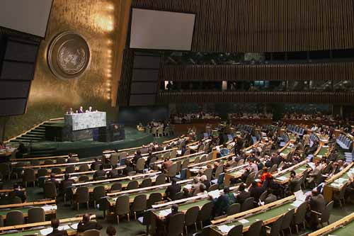
Cont’d

Slide 31
1.7.2. Realism
Realists argue that:
  Values are context bound,
  Morality is determined by interest,
  Morality and ethics and law are irrelevance
  The conditions of the present are determined by historical processes.
The formative assumptions of realism are:
  the international system is ‘anarchic’- it is devoid of an all-encompassing authority.
  International law is non-binding and ineffective in the regulation of relations between states.
  Conflict is an inevitable and unavoidable -continual feature of IR.
  So, war is common and inherent to humankind.
  periods of peace are merely times when states are preparing for future conflict.

Slide 32
Cont’d
  human beings are inherently not good, or have not the potential for good.
  People are selfish and act in their own self-interests.
  Focus on the centrality of the state.
  The need for state security and survival truly rely on the state itself.
  So, power is the only thing that matters due to:
    Human nature
    Anarchic world
  states partake in IO only when it is in their self-interest.
  All nations are self-reliant
  Quest for military and/or economic security
  To preserve peace use Balance of Power

Slide 33
Cont’d
Key thinkers: Thucydides, Machiavelli, Hobbes, Kissinger, Hans Morgenthau and Kenneth Waltz .
Hans Morgenthau, Politics among Nations (1948), power is an objective category which is universally valid, but not fixed once and for all.
He assumes that :
  International politics is a struggle for power-have universal applicability.
  politics is primarily about domination as opposed to cooperation between states.
  A clear separation of fact and value, of theory and practice.
  His famous statement -“all politics is a struggle for power” (Morgenthau 1948).
Realism gained momentum during the WW II.
Kenneth Waltz (1959 and 1979) defines a neo-realist agenda
The IS for Waltz is anarchical and hence perpetually threatening and conflicting.

Slide 34
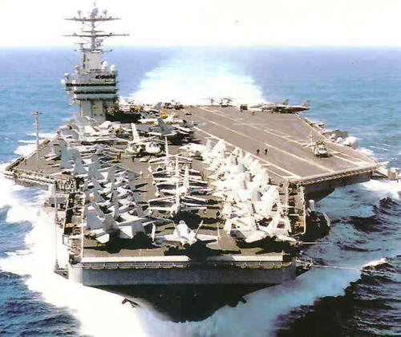
Cont’d

Slide 35
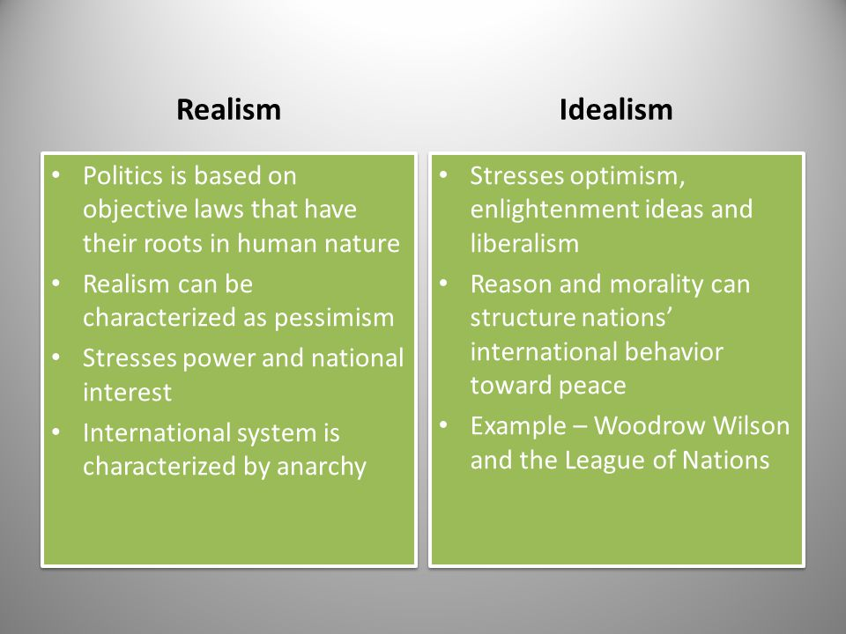
Cont’d

Slide 36
1.7.3. Structuralism/Marxism
Inspired by the writings of Marx and Lenin as a critique of both realism and pluralism.
Argues that a capitalist society is divided into two contradictory classes;
  The business class (the bourgeoisie) and
  The working class (the proletariat).
The proletariats are at the mercy of the bourgeoisie who control their wages and therefore their standard of living.
Hoped for an eventual end to the class society and overthrow of the bourgeoisie by the proletariat.
There is inequalities of wealth between the rich ‘North’ or the ‘First World’ and the poor ‘South’ or the ‘Third World’.
Focused on dependency, exploitation and the international division of labor .
Capitalists (owners) exploit workers (proletariat)

Slide 37
Cont’d
This relegated the vast majority of the global population to the extremes of poverty.
Reject the realist/liberal view of state conflict or cooperation.
Marxists view the international system as an integrated capitalist system in pursuit of capital accumulation.
The final goal, toward which socialist society would constantly build- "communism".
State as “Executive Committee of the Ruling (Corporate) Class”.
Role of state is to ensure overall stability of global capitalist economy.
Imperialism generated by the vigor of free enterprise capitalism in the West and by state capitalism in the socialist bloc.
This imposed unequal exchange of every kind upon the Third World.

Slide 38
Cont’d
Capitalist structure of the IS which accrued benefits to some while causing the impoverishment of the vast majority of others.
The pre-dominated class system within capitalist societies had its parallel globally; producing centre–periphery relations .
Neo-Marxist structuralism viewed these processes as the basis of inequality, the debt burden, violence and instability.

Slide 39
1.7.4. Constructivism
Commonly viewed as a middle ground.
States have identity
State identity influences the way states interact with each other.
states and other major actors as well as the identities that guide these states and actors,
highlight the importance of values and shared interests between individuals who interact on the global stage.
Nation-states are not all alike .
Political culture, Domestic political trends, form of government and history shapes foreign policy.
The structure of the system is based on states’ shared beliefs about the rules of international behavior
Behavior is driven by ideas: states behave on the basis of their understanding of their own identity and principles.

Slide 40
Cont’d
Alexander Wendt, described the relationship between agents (individuals) and structures (the state) mutually constitute each other: structures constrain and construct the identities and interests of agents.
His famous phrase “anarchy is what states make of it” (Wendt 1992).
Perception of reality is socially constructed
Then, different states can perceive anarchy differently and the qualities of anarchy can even change over time.
The essence of IR exists in the interactions between people.
States do not interact; it is agents of those states who interact.
To understand constructivism is to understand that ideas, or “norms” as they have power.
IR is never-ending journey of change in the accumulation of the accepted norms of the past and the emerging norms of the future.

Slide 41
1.7.5. Critical Theories
Refer to a wide spectrum of theories
Established in response to mainstream approaches, mainly liberalism and realism.
They oppose commonly held assumptions in the field of IR .
They altered circumstances call for new approaches in the world we find ourselves in.
Valuable because they identify positions that have typically been ignored or overlooked within IR.
Provide a voice to individuals who have frequently been marginalized.
In order to change the inequality in the IR, they argue that the legitimacy of the state must be questioned and ultimately dissolved.
So, emancipation from the state in some form is often part of the wider critical agenda.

Slide 42
Cont’d
It can be seen as an instrument of the powerless to advance more equitable types of global relations.
Shines a light on how the traditional approaches feed the imbalances of an unjust global order by failing to question their foundational claims.
The focus of critical theorists is a political inquiry with an explicit emancipatory purpose.
Post-colonialism differs from Marxism by focusing on the inequality between nations or regions, as opposed to classes.
This approach acknowledges that politics is vital also to include the voices of individuals from other parts of the world.
Aims at uncovering the potential for a fairer system of global relations.
They argue that the existing relations excludes the potential for human understanding and mutual recognition.

Slide 43
Cont’d
looks in particular to how the dynamics of global capitalism are producing failed states throughout Africa and the Middle East.
Critical theory, more than other approaches, promises to go deeper in understanding why refugees have to leave their homes.
Edward Said (1978) developed ‘Orientalist’ critique, describing how the Middle East and Asia were inaccurately depicted in the West.
Postcolonial scholars are important contributors to the field.
The main challenge for critical theory then is to connect theory to practice- to set up a theoretical lens that results in a real-world transformative outcome.

Slide 44
The End!!!

